Slide 1
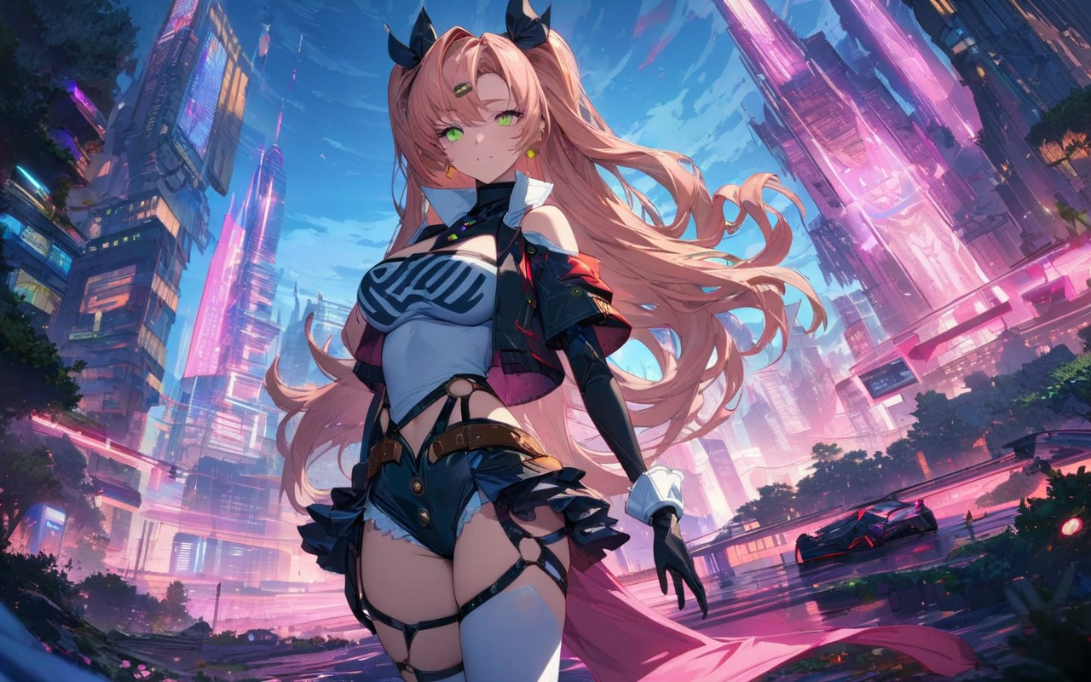
Notes:
score_9, score_8_up, score_8, medium breasts, (curvy), cute, eyelashes,
BREAK,
nicole demara, green eyes, pink hair, hair ornament, hair ribbon, hairclip, long hair, mole, mole on breast, mole on thigh, mole under eye, two side up, ribbon,
BREAK,
wearing (retro 70s clothes) at the river, patterned dress, white with blue spots, short sleeves, v-neckline, textured fabric sandy beach, ocean horizon, clear sky, distant figures seated position, leaning forward, one leg bent,
BREAK,
smile, looking at viewer,
abstract background, white outline,
zPDXL, Expressiveh

Slide 2
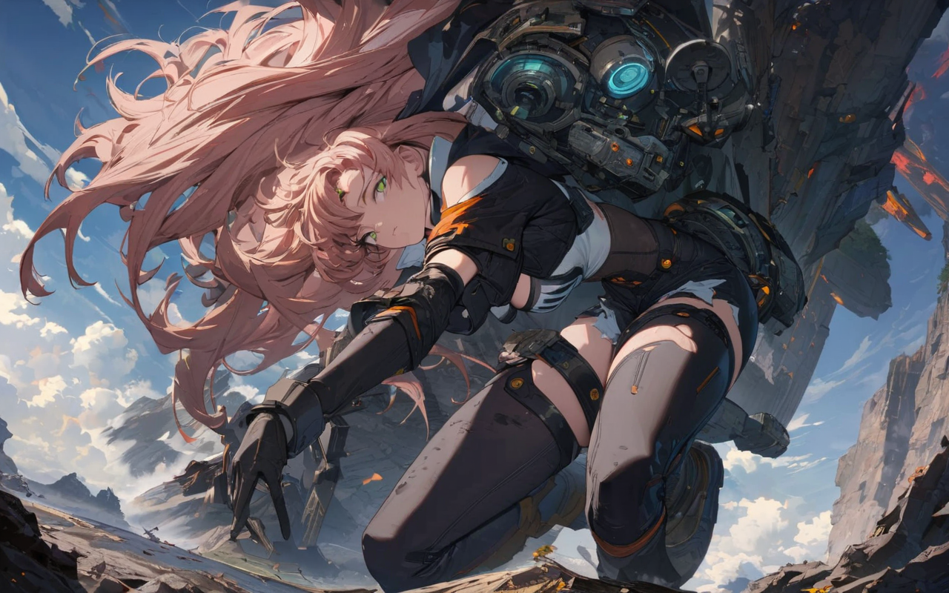
Notes:
score_9, score_8_up, score_8, medium breasts, (curvy), cute, eyelashes,
BREAK,
nicole demara, green eyes, pink hair, hair ornament, hair ribbon, hairclip, long hair, mole, mole on breast, mole on thigh, mole under eye, two side up, ribbon,
zzLFashion, frilled dress, frills, bow, dress,
smile,
zPDXL,

Slide 3
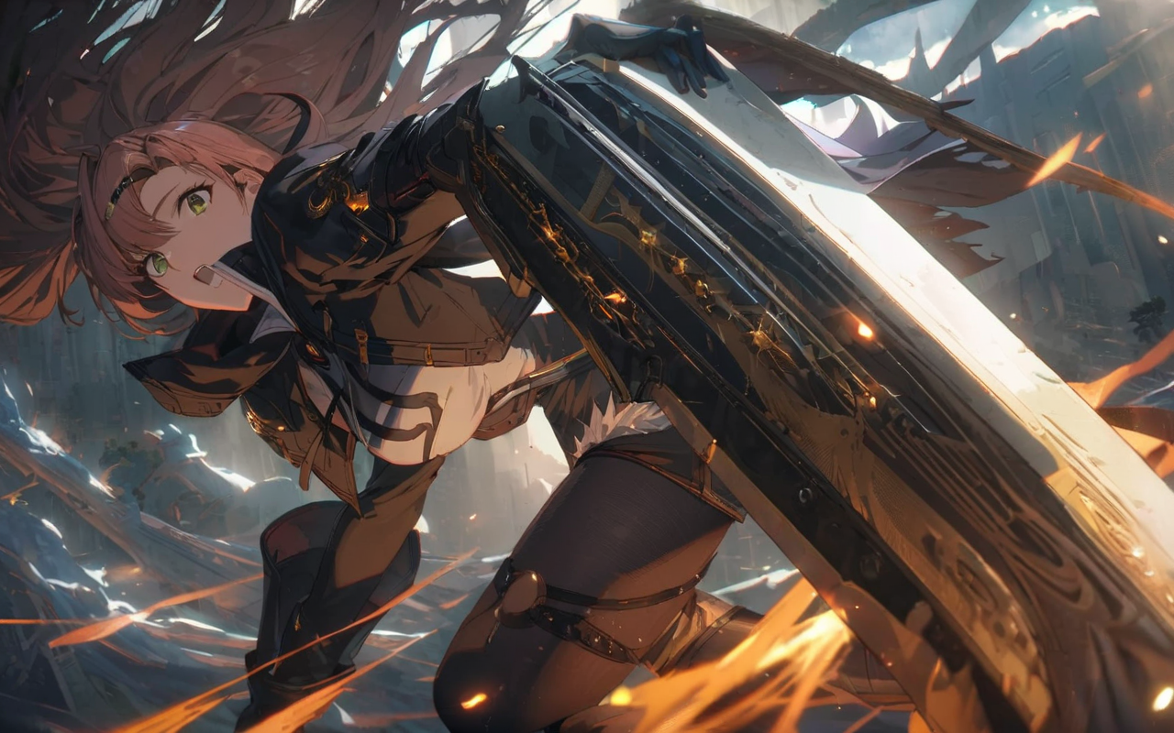
Notes:
score_9, score_8_up, score_8, medium breasts, (curvy), cute, eyelashes, nicole demara, green eyes, pink hair, hair ornament, hair ribbon, hairclip, long hair, mole, mole on breast, mole on thigh, mole under eye, two side up, ribbon,, closed mouth, alternate costume, smile, nail polish, looking at viewer, hand up, collared shirt, blush, sweater, black skirt, black nails, eyelashes, long sleeves, sleeves past wrists, plaid skirt, shoulder bag, black bag, blurry, tile floor, pleated skirt, white shirt ,<lora:MarnieP3:0.8>, <lora:Vivid:0.7>, <lora:princess_xl_v2:0.6>,
zPDXL,

Slide 4
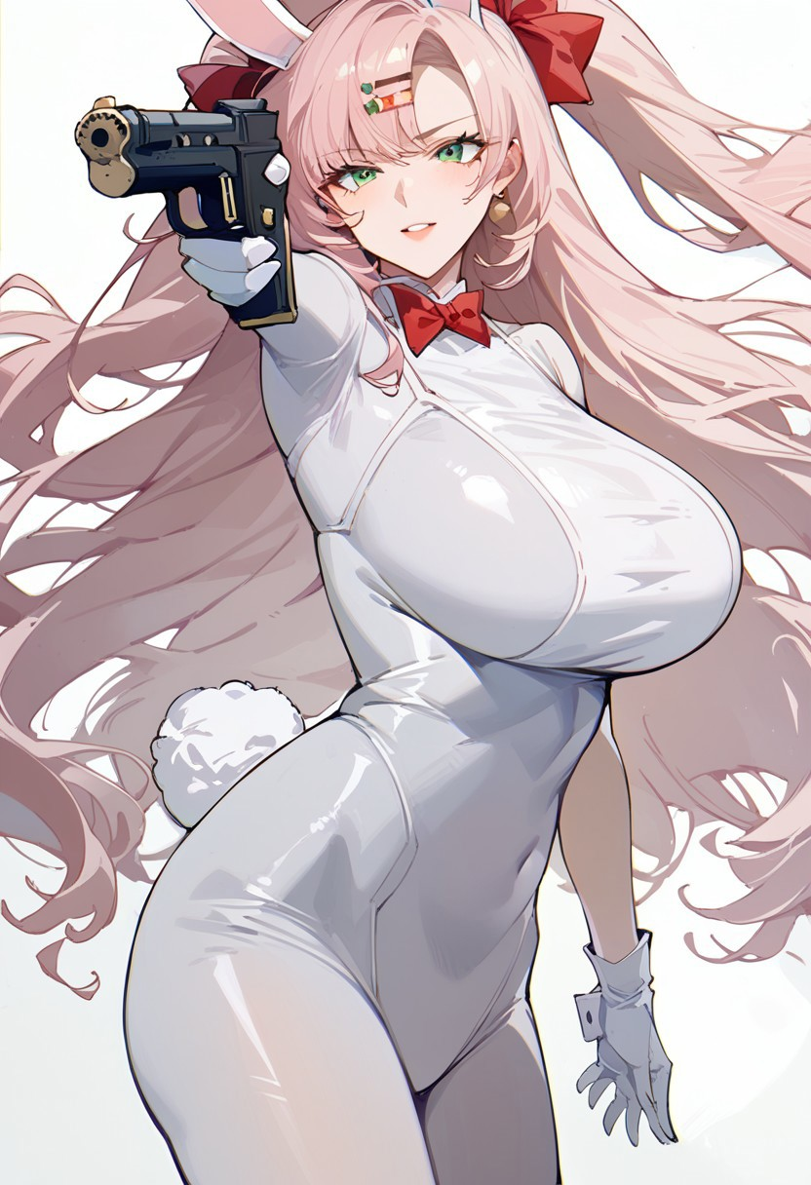
Notes:
score_9,score_8_up,score_7_up,<lora:zzz_all_pony_v1:1>,grey_background, middle_finger, puffy_short_sleeves, hand_between_legs, solo, maid_headdress, 1girl, highres, full_body, blurry_background, upper_teeth_only, frilled_apron, absurdres, film_grain, frilled_hairband, black_pantyhose, ellen_joe, white_apron, black_dress, hand_up, simple_background, shadow, blunt_ends, high_heels, large_breasts, looking_at_viewer, open_mouth, black_footwear, knee_up

Slide 5
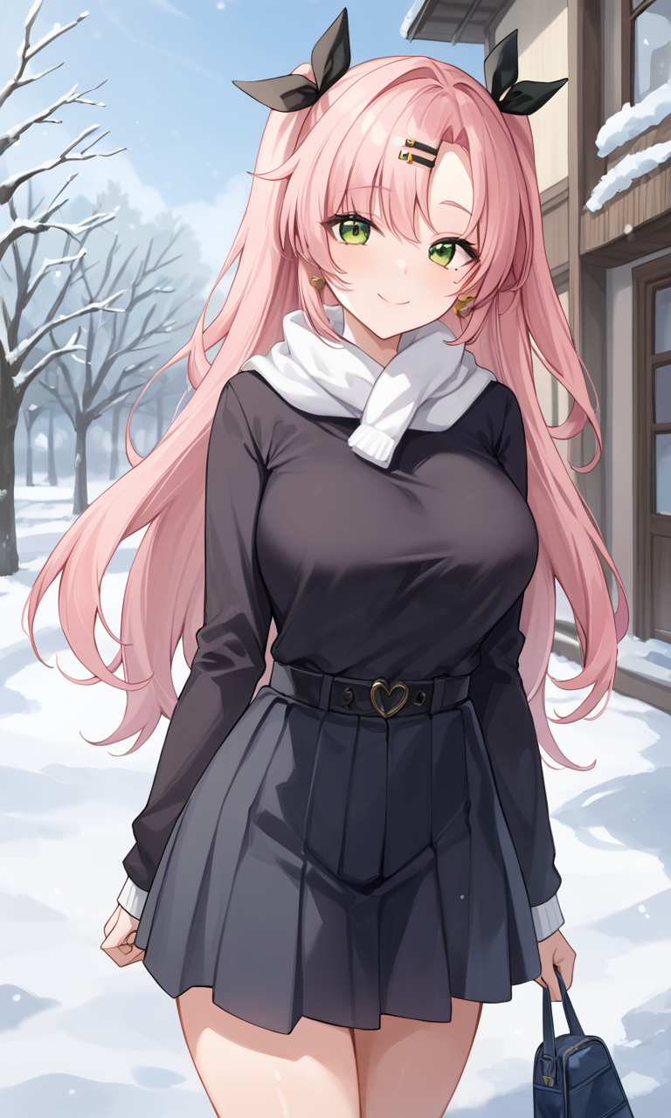
Notes:
score_9,score_8_up,score_7_up,<lora:zzz_all_pony_v1:1>,grey_background, middle_finger, puffy_short_sleeves, hand_between_legs, solo, maid_headdress, 1girl, highres, full_body, blurry_background, upper_teeth_only, frilled_apron, absurdres, film_grain, frilled_hairband, black_pantyhose, ellen_joe, white_apron, black_dress, hand_up, simple_background, shadow, blunt_ends, high_heels, large_breasts, looking_at_viewer, open_mouth, black_footwear, knee_up

Slide 6
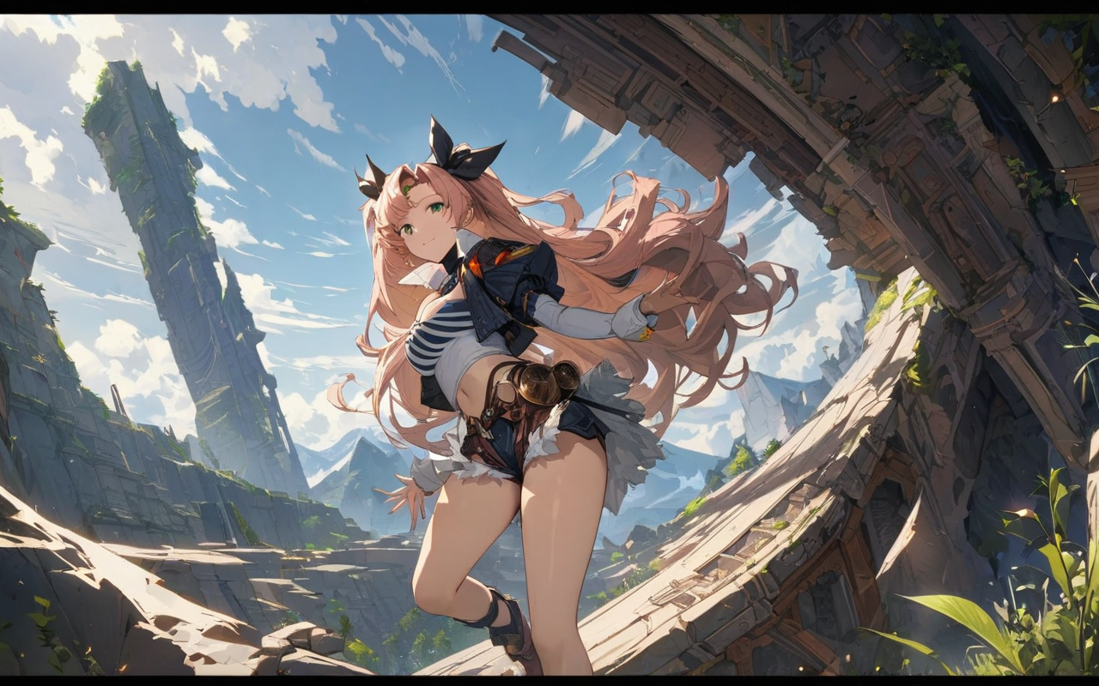
Notes:
score_9, score_8_up, score_8, medium breasts, (curvy), cute, eyelashes, nicole demara, green eyes, pink hair, hair ornament, hair ribbon, hairclip, long hair, mole, mole on breast, mole on thigh, mole under eye, two side up, ribbon,, closed mouth, alternate costume, smile, nail polish, looking at viewer, hand up, collared shirt, blush, sweater, black skirt, black nails, eyelashes, long sleeves, sleeves past wrists, plaid skirt, shoulder bag, black bag, blurry, tile floor, pleated skirt, white shirt ,<lora:MarnieP3:0.8>, <lora:Vivid:0.7>, <lora:princess_xl_v2:0.6>

Slide 7
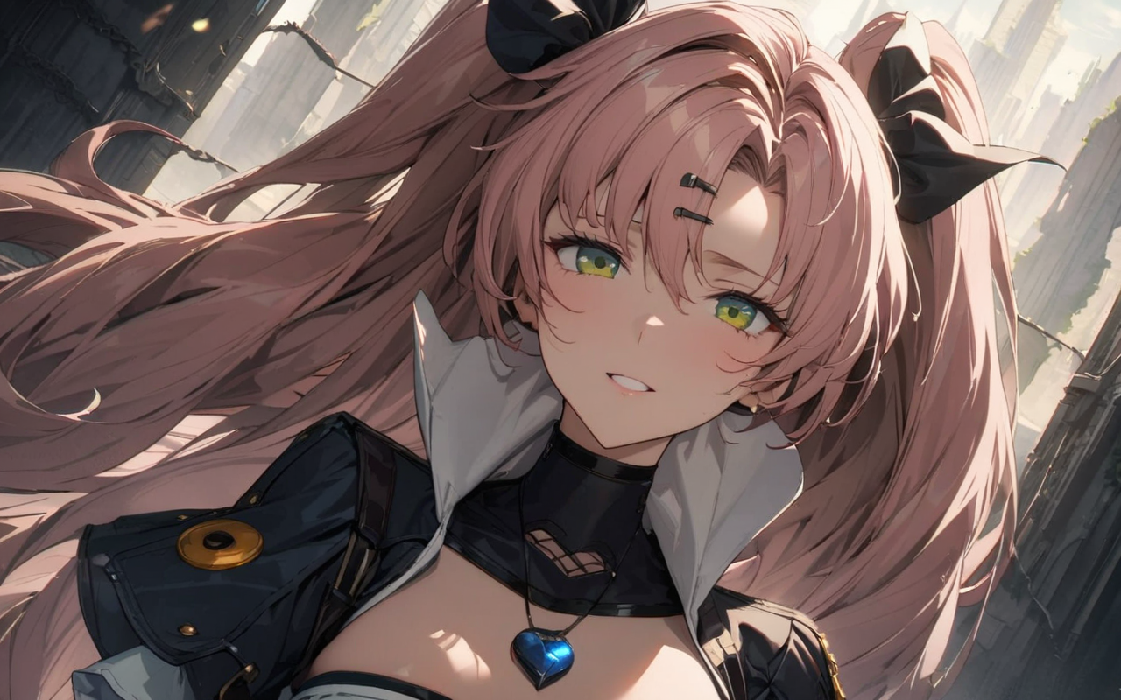
Notes:
score_9, score_8_up, score_8, medium breasts, (curvy), cute, eyelashes, nicole demara, green eyes, pink hair, hair ornament, hair ribbon, hairclip, long hair, mole, mole on breast, mole on thigh, mole under eye, two side up, ribbon,, closed mouth, alternate costume, smile, nail polish, looking at viewer, hand up, collared shirt, blush, sweater, black skirt, black nails, eyelashes, long sleeves, sleeves past wrists, plaid skirt, shoulder bag, black bag, blurry, tile floor, pleated skirt, white shirt ,<lora:MarnieP3:0.8>, <lora:Vivid:0.6>,

